Slide 1
Lab - Named Target Servers

Slide 2
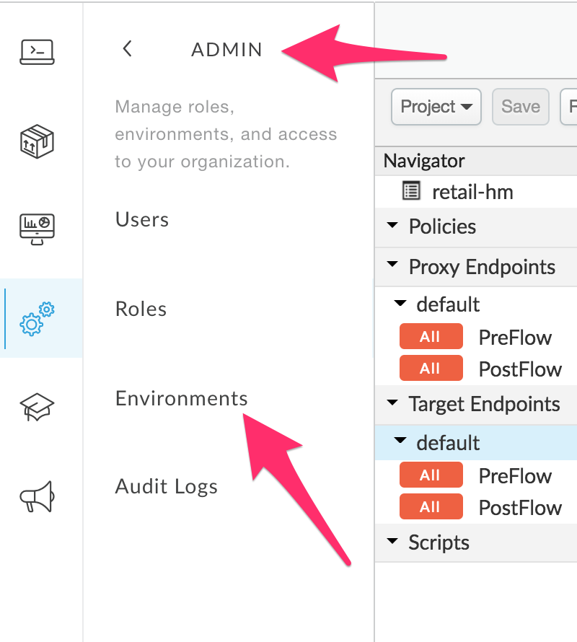
Wherein ...
We realize our Target connection is hardcoded, and
Create a parameterized Target Server based on the Org Environment

Slide 3
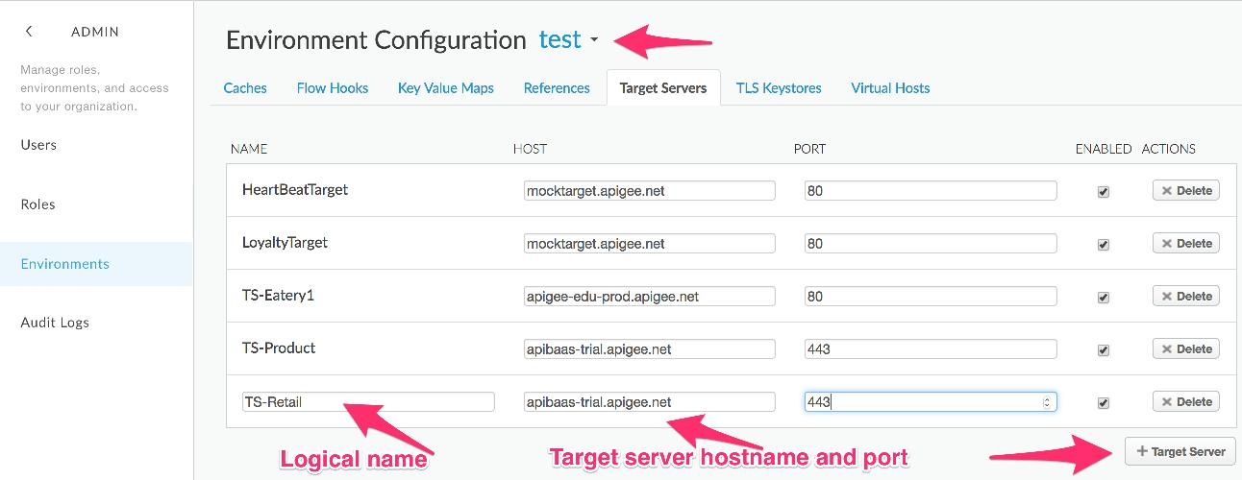
Create a Target Server
Click on Edit, then click on +Target Server.

Slide 4
Target Servers
Step 1: Create Target Servers ("Environment Configuration")
Step 2: Configure Target Servers vs. the HTTP Target URL ("default" Target Server)
<HTTPTargetConnection>
<!-- URL>https://apibaas-trial.apigee.net/ssvaidyanathan/labs01</URL -->
<LoadBalancer>
<Server name="TS-Retail"/>
</LoadBalancer>
<Path>/ssvaidyanathan/labs01</Path>
</HTTPTargetConnection>
Old Target URL
NewTarget uses "Load Balancer" & "Path"

Slide 5
Target Servers - Enable SSL via the Mgmt API
Step 1: Goto Smartdocs page for the Update Target Server Mgmt API
https://docs.apigee.com/management/apis/put/organizations/{org}/environments/{env}/targetservers/{targetserver}
Replace the {org}, {env}, {targetserver} with your values.
Step 2: Edit the request payload as below:
{
"name" : "TS-Retail",
"host" : "apibaas-trial.apigee.net",
"isEnabled" : true,
"port" : 443,
"sSLInfo": {
"enabled": "true"
}
}

Slide 6
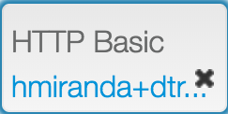

Target Servers - Enable SSL via the Mgmt API
Step 3: Supply your username/password org admin credentials
Step 4: Click Send this request button
{
"name" : "TS-Retail",
"host" : "apibaas-trial.apigee.net",
"isEnabled" : true,
"port" : 443,
"sSLInfo": {
"enabled": "true"
}
}

Slide 7
Test your proxy
Test again with the /categories and other resources to:
http://<your-orgname>-test.apigee.net/retail/v1/categories
http://<your-orgname>-test.apigee.net/retail/v1/products
http://<your-orgname>-test.apigee.net/retail/v1/stores

Slide 8
THANK YOU

